Slide 1
Res-VGG: A Novel Model for Plant Disease Detection by Fusing VGG16 and ResNet Models
2nd International Conference on Machine Learning, Image Processing,
Network Security and Data Sciences (MIND-2020), Paper ID: 186
Presented By
Ashish Kumar

Slide 2
Abstract
Dataset
Pre-processing of Images
Existing Model
CONTENTS
Proposed Model
Result Comparision
Conclusion
References

Slide 3
Abstract
Agriculture is one of the major growing sectors in India, and plant disease is one of the important factors that affect it. Plant disease management is becoming a major challenge to ensure food safety and sustainability of agriculture. Deep learning (DL) has recently made some good walk-through in the field of image identification and its classification. In this paper, we have proposed a new model called Res-VGG that hybridized two different DL models which are VGG16 and ResNet. This model is implemented along with several visualization techniques to detect and categorize the symptoms of plant diseases. In our proposed model, we have used a total of 12 layers consisting of 9 convolutional layers, two fully connected layers, and one softmax layer. The effectiveness of this proposed model is tested and validated using Plant Village Dataset. The experimental analysis reveals that the proposed model is superior to the existing models in terms of plant disease detection, so that effective preventive measures can be taken for eliminating these diseases, thus removing the problem of food security.

Slide 4
Dataset
The dataset is downloaded from https://plantvillage.psu.edu/.
It has 38 crop-disease sets with 26 crop disease categories(e.g., Apple, Cherry, Corn.., Tomato) which include a total of 67,848 images of leaves for training and 16, 973 for validation.

Slide 5
Pre-Processing of images
The input of our model Res-VGG is 224 X 224 RGB images, so transforming images into given input size.
Re-scaling the pixel values (between 0 and 255) to the [0,1], where 0 and 255 represents black and white respectively(converting mean to 0 and standard deviation to 1).
We have used a batch size of 128.

Slide 6
EXISTING
MODELS

Slide 7
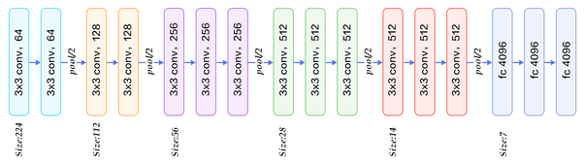
VGG-16

Slide 8
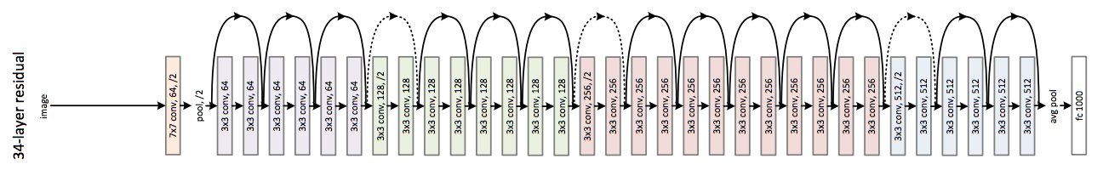
RESNET

Slide 9
PROPOSED
MODEL
RES-VGG

Slide 10
RES-VGG

Slide 11
Configuration

Slide 12
Architecture
Res-VGG has 12 layers, comprising of nine convolutional layers, two fully connected layers, and one SoftMax classifier for classifying 38 classes of plant disease.
It uses both kernel size of 3X3 and 5X5.
It also uses both Max and Avg Pooling operations.
Activation function used is ReLU.
For avoiding overfitting we have used dropout.

Slide 13
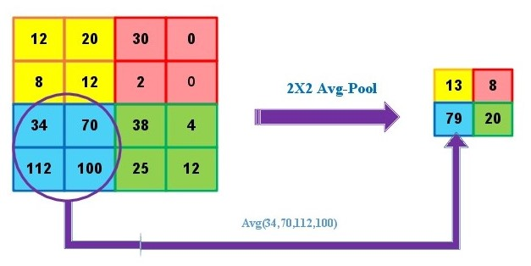
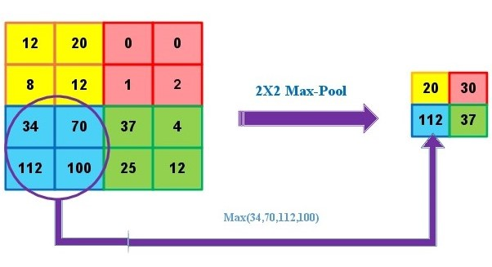
POOLING OPERATION
Average pooling
Max pooling

Slide 14
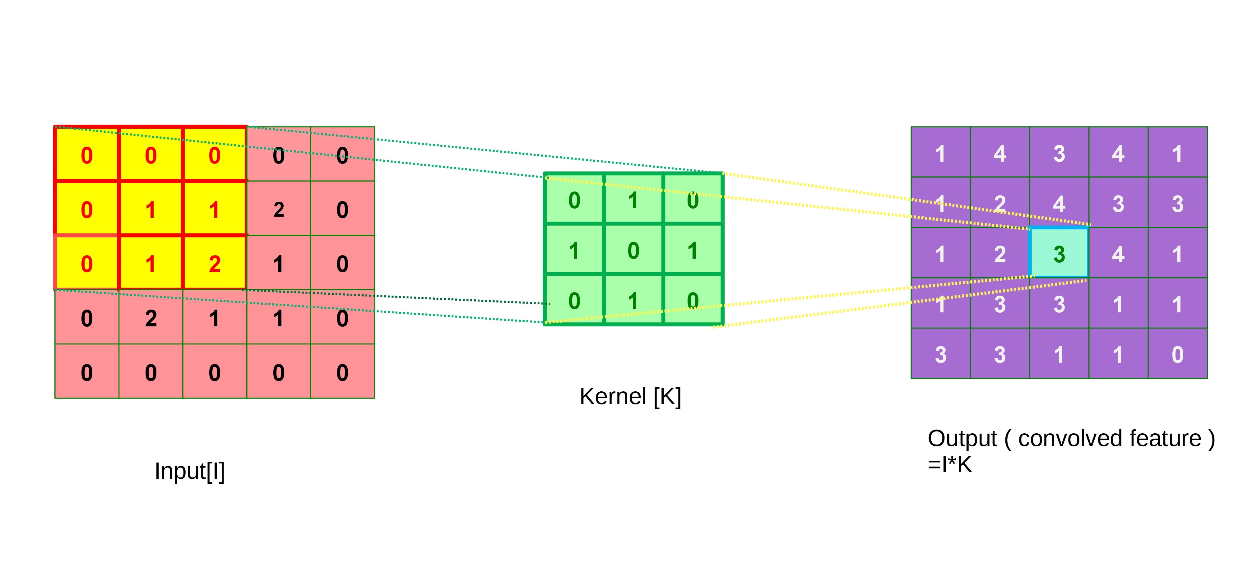
CONVOLUTION OPERATION

Slide 15
Optimization algorithms / Loss function
Optimization Algorithms
We have used Stochastic gradient Descent (SGD) optimizer,in which for every x and y it is going to update the weights accoring to the formula.
Loss Function
We have used Cross-entropy loss or log loss.
Cross-entropy loss increments as the anticipated
probability diverges from the real label

Slide 16
RESULT COMPARISION

Slide 17
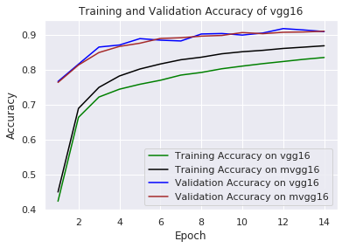
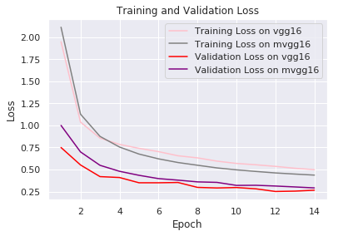
Comparing results of vgg and modified vgg

Slide 18
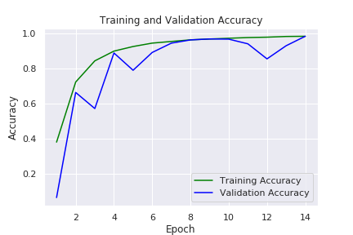
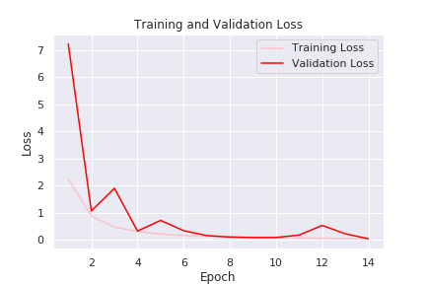
RESULT OF RES-VGG

Slide 19
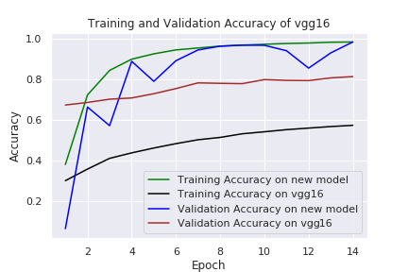
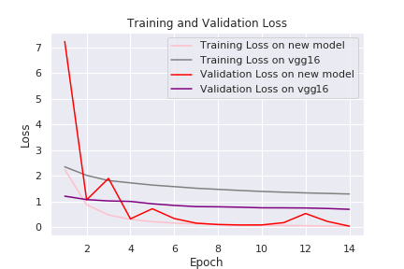
COMPARING VGG AND RES-VGG

Slide 20
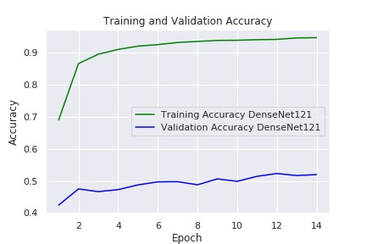
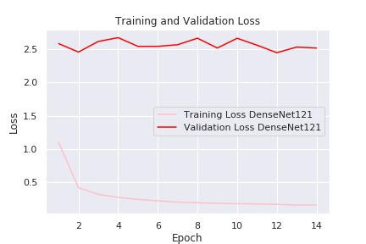
RESULT OF DENSENET 121

Slide 21
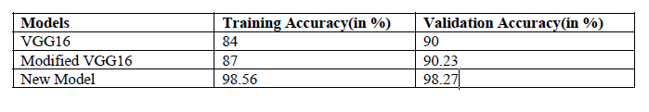
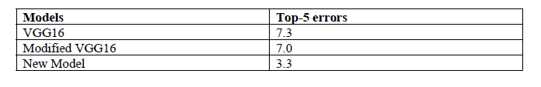
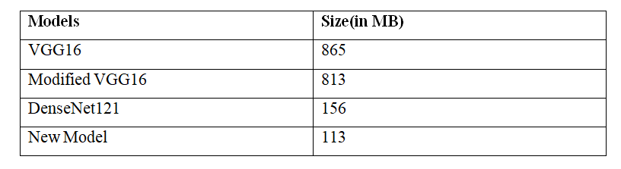
COMPARISION OF ACCURACY AND ERRORS
Comparison results of different methods
Comparison errors of different methods
Trained Model Size Comparision

Slide 22
CONCLUSION
This paper has examined the pre-trained model (VGG16) and compare the results with the modified VGG16 (mVGG) and the proposed model (Res-VGG). To achieve an effective and efficient model, we have tuned the kernel size, pooling layer, convolutional layer, and optimization techniques. This proposed model(Res-VGG) eliminates the problems of the pre-trained model(VGG16) and modified model(mVGG16) that is experimentally shown with the Plant-Village dataset. The fact that the proposed model outperforms than the existing models because of using the kernel of different sizes and both the pooling algorithm i.e. max and average pooling. In this proposed model, we have used 5x5 kernels at the input end and also both the max and average pooling functions. In the future, any large dataset may be trained using this proposed model or it can be modified accordingly for better performance. This can be suitable for farmers to detect the diseases and take preventive measures accordingly.
As we have datasets of only 38 crop diseases. So, in the future, if more classes of crop diseases are available, the model which is proposed in this paper can be used or if required it can be modified and trained on the available datasets. This can help farmers in many ways as we can detect diseases with our model and help them in protecting their crops from diseases. Since, as we know that food is a very important part and for the production of crops so, we can help them with our technology, and provide the chance to see a new future.

Slide 23
REFERENCES
[1]Barbedo, J. G. A. (2016). A review of the main challenges in automatic plant disease identification based on visible range images. Biosystems Engineering, 144, 52-60.
[2]LeCun, Y., Bengio, Y., & Hinton, G. (2015). Deep learning. nature, 521(7553), 436-444.
[3]Sahoo, A. K., Pradhan, C., & Das, H. (2020). Performance Evaluation of Different Machine Learning Methods and Deep-Learning Based Convolutional Neural Network for Health Decision Making. In Nature Inspired Computing for Data Science (pp. 201-212). Springer, Cham.
[4]Krizhevsky, A., Sutskever, I., & Hinton, G. E. (2012). Imagenet classification with deep convolutional neural networks. In Advances in neural information processing systems (pp. 1097-1105).
[5]Szegedy, C., Ioffe, S., Vanhoucke, V., & Alemi, A. A. (2017, February). Inception-v4, inception-resnet and the impact of residual connections on learning. In Thirty-first AAAI conference on artificial intelligence.

Slide 24
REFERENCES
[6]Simonyan, K., & Zisserman, A. (2014). Very deep convolutional networks for large-scale image recognition. arXiv preprint arXiv:1409.1556.
[7]He, K., Zhang, X., Ren, S., & Sun, J. (2016). Deep residual learning for image recognition. In Proceedings of the IEEE conference on computer vision and pattern recognition (pp. 770-778).
[8]Huang, G., Liu, Z., Van Der Maaten, L., & Weinberger, K. Q. (2017). Densely connected convolutional networks. In Proceedings of the IEEE conference on computer vision and pattern recognition (pp. 4700-4708).
[9]Mohanty, S. P., Hughes, D. P., & Salathé, M. (2016). Using deep learning for image-based plant disease detection. Frontiers in plant science, 7, 1419.
[10]Sladojevic, S., Arsenovic, M., Anderla, A., Culibrk, D., & Stefanovic, D. (2016). Deep neural networks based recognition of plant diseases by leaf image classification. Computational intelligence and neuroscience, 2016.
[11]Dyrmann, M., Karstoft, H., & Midtiby, H. S. (2016). Plant species classification using deep convolutional neural network. Biosystems Engineering, 151, 72-80.

Slide 25
REFERENCES
[12]Sa, I., Ge, Z., Dayoub, F., Upcroft, B., Perez, T., & McCool, C. (2016). Deepfruits: A fruit detection system using deep neural networks. Sensors, 16(8), 1222.
[13]Athanikar, G., & Badar, P. (2016). Potato leaf disease detection and classification system. International Journal of Computer Science and Mobile Computing, 5(2), 76-88.
[14]Samanta, D., Chaudhury, P. P., & Ghosh, A. (2012). Scab disease detection of potato using image processing. International Journal of Computer Trends and Technology, 3(1).
[15]D. Hughes, M. Salathe, et al., An open access repository of images on plant health to enable the development of mobile disease diagnostics, arXiv preprint arXiv:1511. 08060 (2015)
[16]Scherer, D., Müller, A., & Behnke, S. (2010, September). Evaluation of pooling operations in convolutional architectures for object recognition. In International conference on artificial neural networks (pp. 92-101). Springer, Berlin, Heidelberg.
[17]Sheng, J., Chen, C., Fu, C., & Xue, C. J. (2018). EasyConvPooling: Random Pooling with Easy Convolution for Accelerating Training and Testing. arXiv preprint arXiv:1806.01729.
[18]Srivastava, N., Hinton, G., Krizhevsky, A., Sutskever, I., & Salakhutdinov, R. (2014). Dropout: a simple way to prevent neural networks from overfitting. The journal of machine learning research, 15(1), 1929-1958.

Slide 26
THANKS

